Slide 1
Money Management System

Slide 2
Introduction
As you know, financial management is crucial for schools to ensure that they have the resources to provide quality education to their students. However, keeping track of expenses and revenues can be a daunting task for school administrators. That's why this project money management system mainly focuses to help schools on to calculate the total money spent on teacher salaries and total money earned from student fees.

Slide 3






Tools used in the Project
Vs Code
React
Spring Boot
Postman
Eureka Server
mongoDB

Slide 4
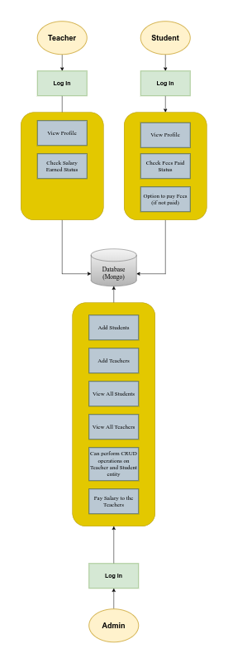
ARCHITECTURE
DIAGRAM

Slide 5
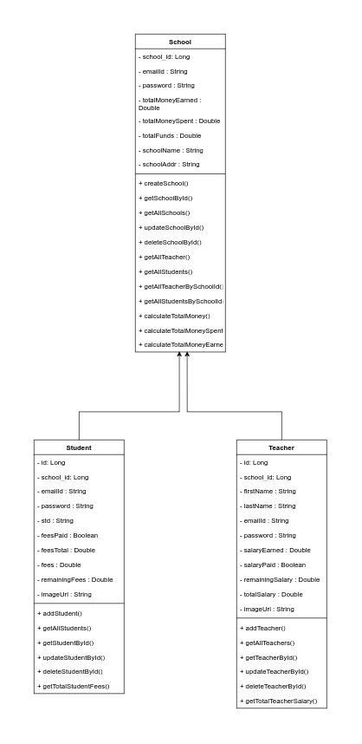
Uml Diagram

Slide 6
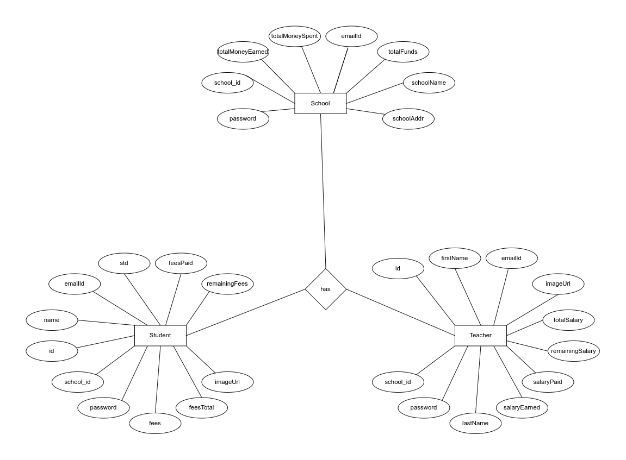
Entity Relationship Diagram

Slide 7
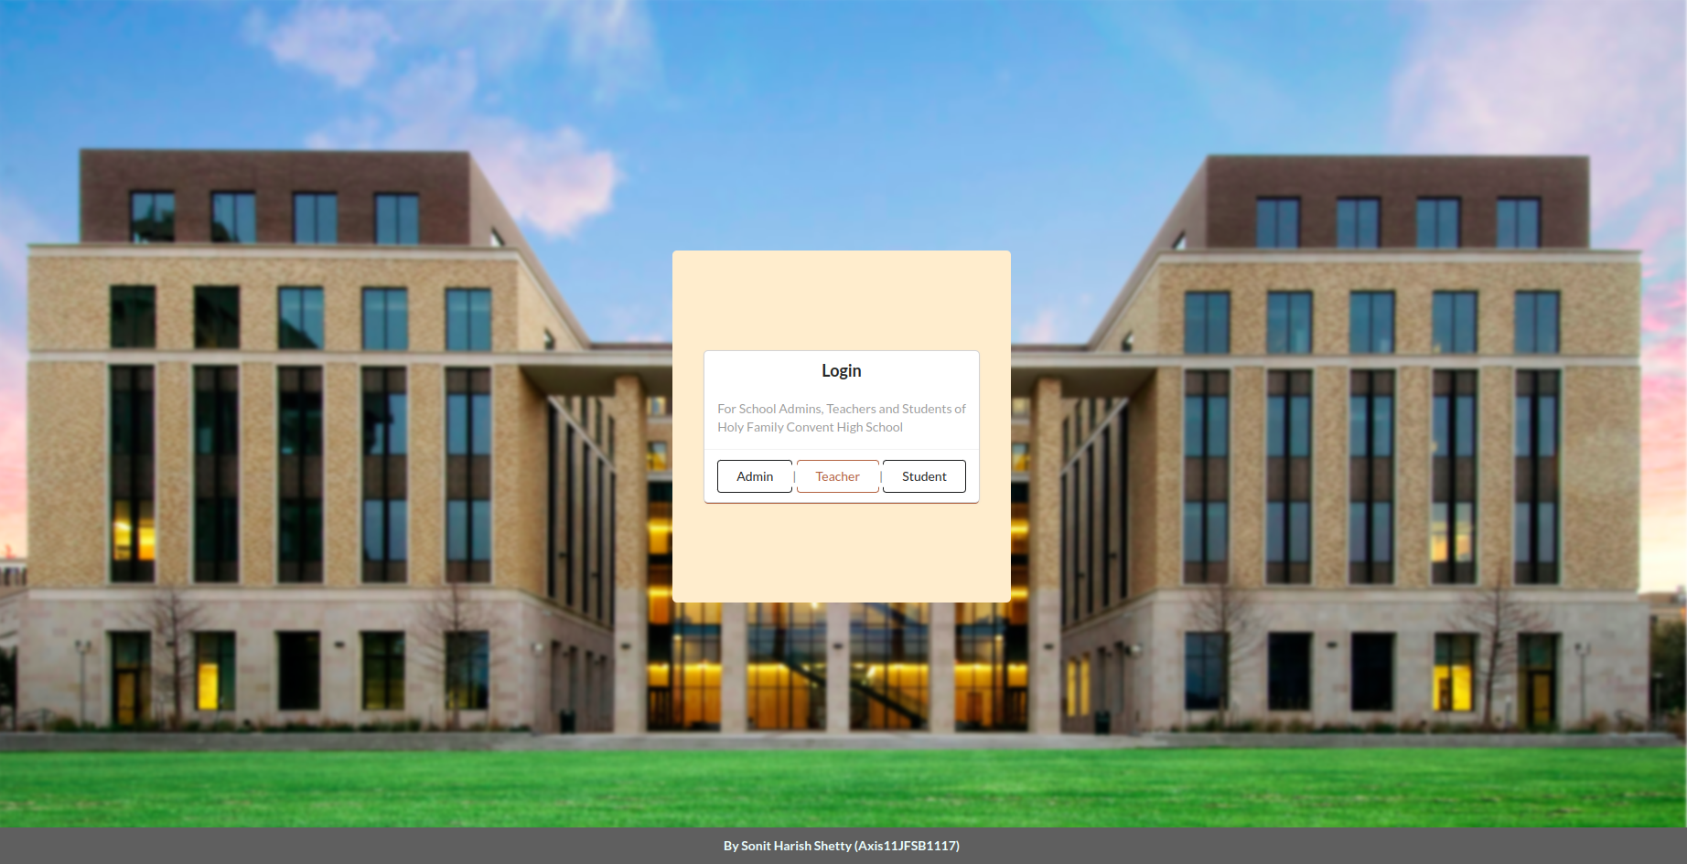
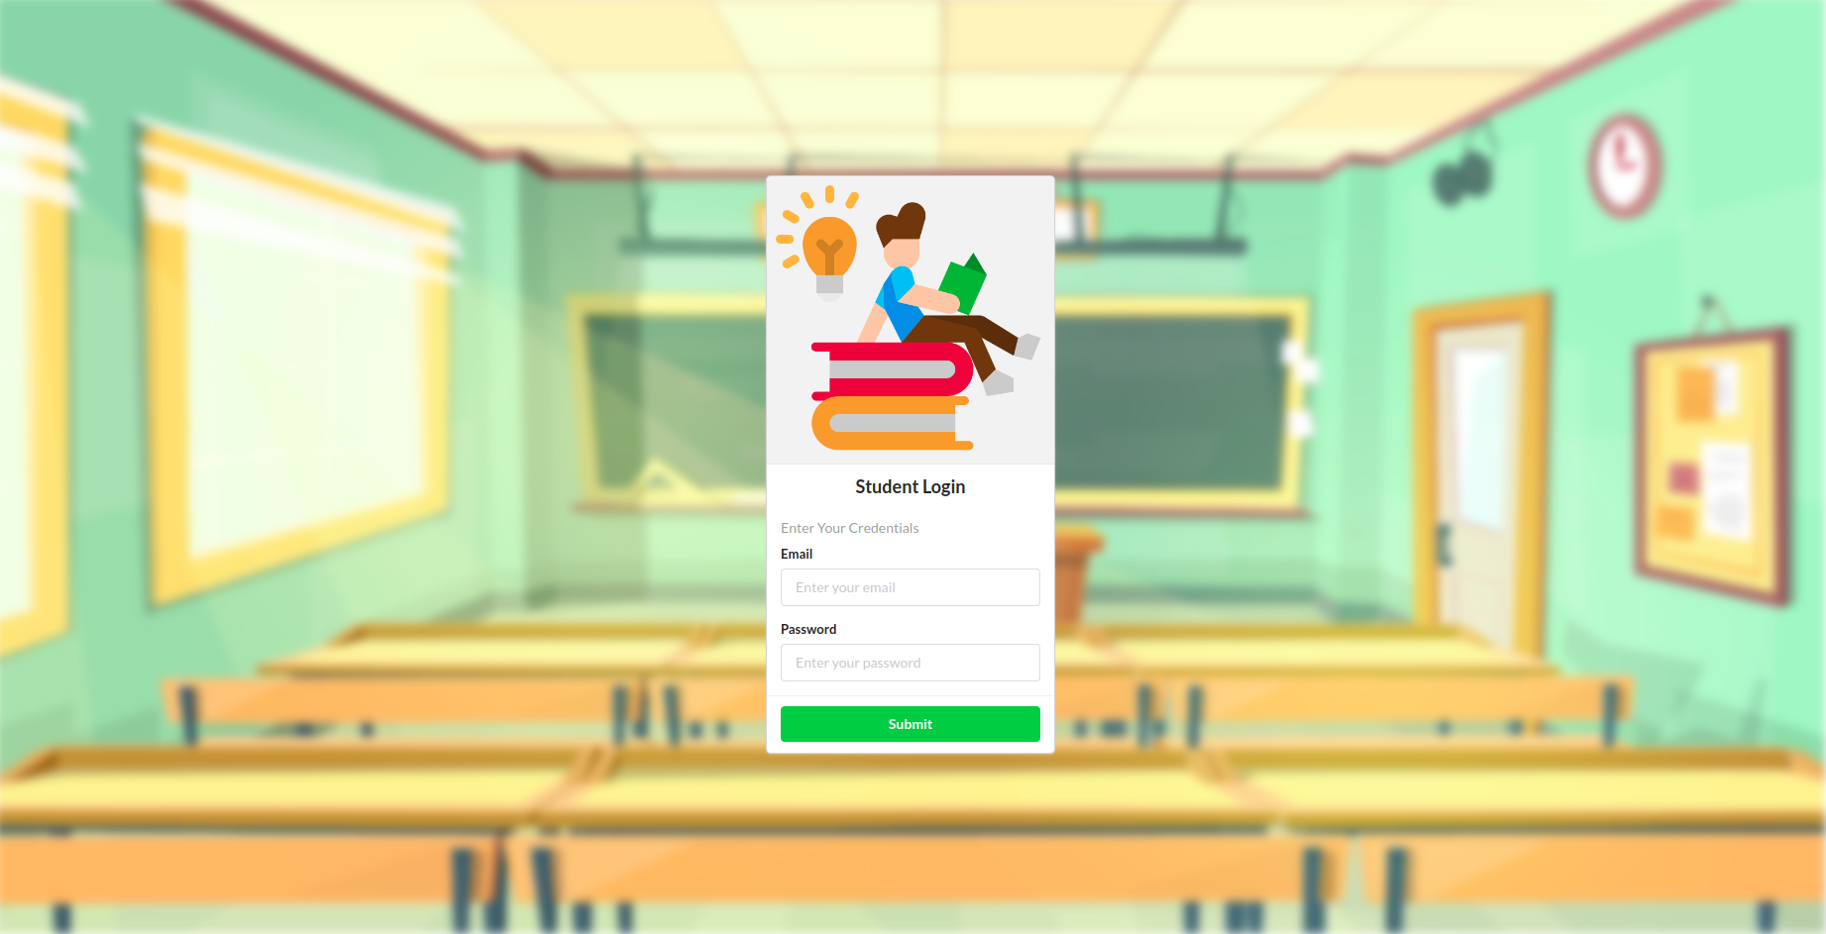
Screenshots
Admin Page
Student Login Page

Slide 8
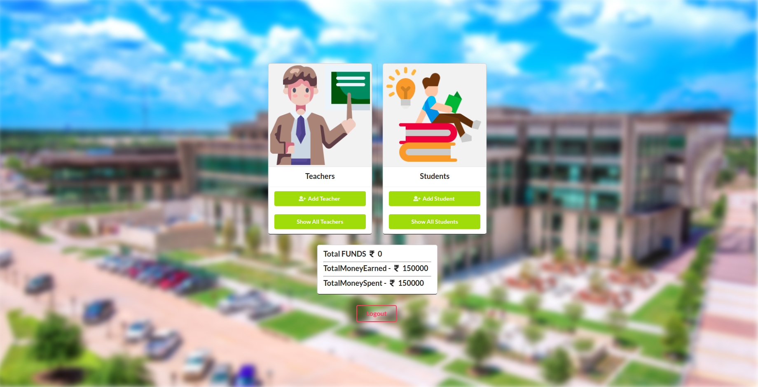
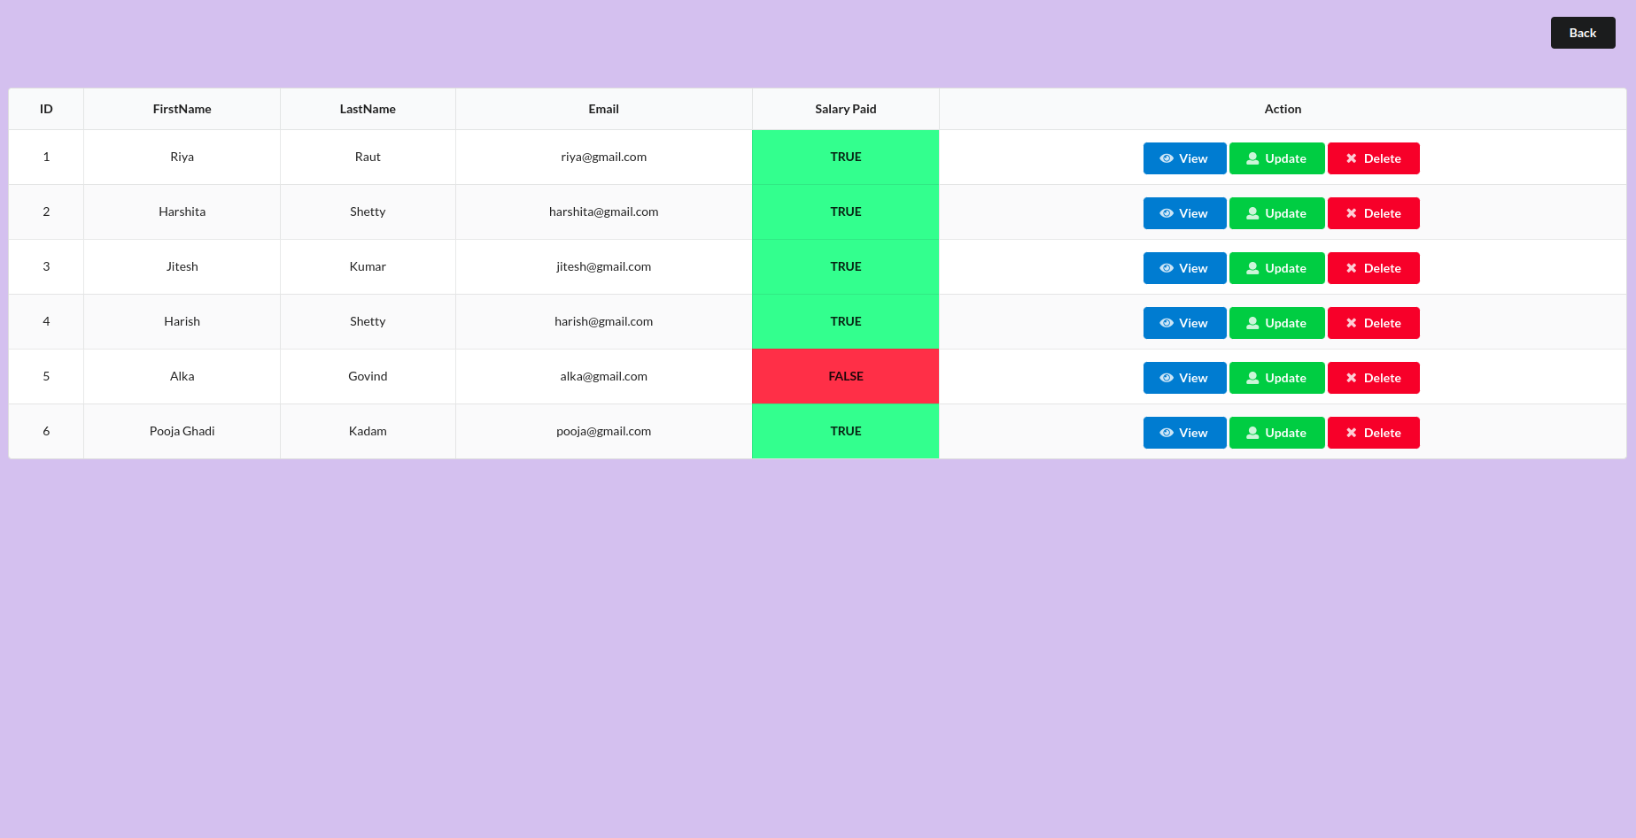
Screenshots
Admin Home Page
View All Teachers Page

Slide 9
CONCLUSION
In conclusion, the money management system project can be a valuable tool for schools looking to improve their financial management practices. The system simplifies the process of calculating total money spent and earned, and it provides administrators to have more insights on all teachers and students and can help them make informed financial decisions. By using this system, schools can save time, reduce errors, and ensure that they have the enough resources or funds to provide quality education to their students.

Slide 10
Sonit Harish Shetty
Thank you!
Unext Reg ID: Axis11JFSB1117

